Slide 1
Chapter 13
Modeling Computation
13.1 Languages and Grammars
Theory of computation
Compiler design
Automata theory
FREE: For Complete Playlist: https://www.youtube.com/c/FahadHussaintutorial/playlists
For Code, Slide and Books: https://fahadhussaincs.blogspot.com/

Slide 2
Chapter 13 Modeling Computation
13.1 Languages and Grammars
Automata theory (also known as Theory Of Computation) is a theoretical branch of Computer Science and Mathematics, which mainly deals with the logic of computation with respect to simple machines, referred to as automata.
Automata enables scientists to understand how machines compute the functions and solve problems. The main motivation behind developing Automata Theory was to develop methods to describe and analyze the dynamic behavior of discrete systems. Automata originated from the word “Automaton” which is closely related to “Automation”.
Now, let’s understand the basic terminologies, which are important and frequently used in the Theory of Computation.

Slide 3
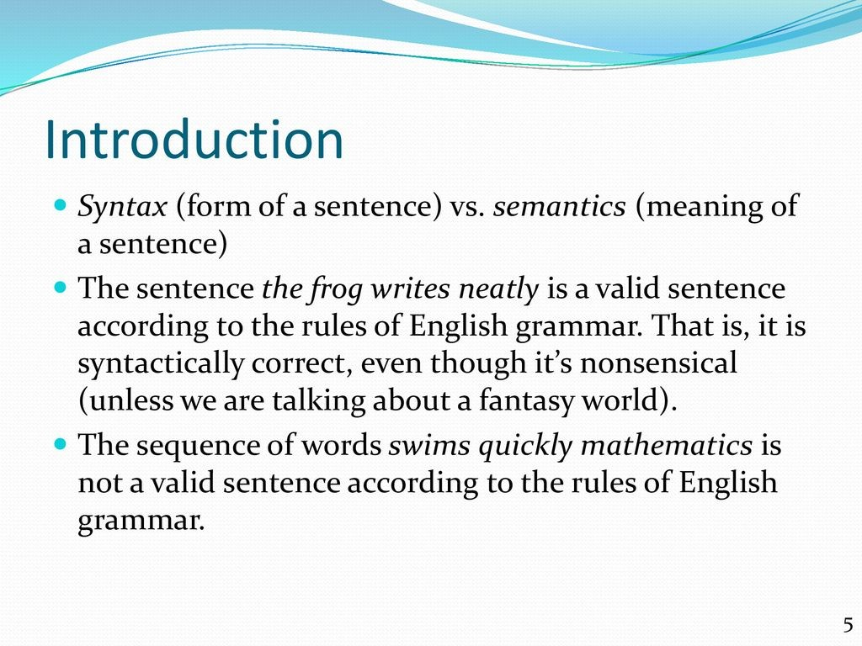

Slide 4
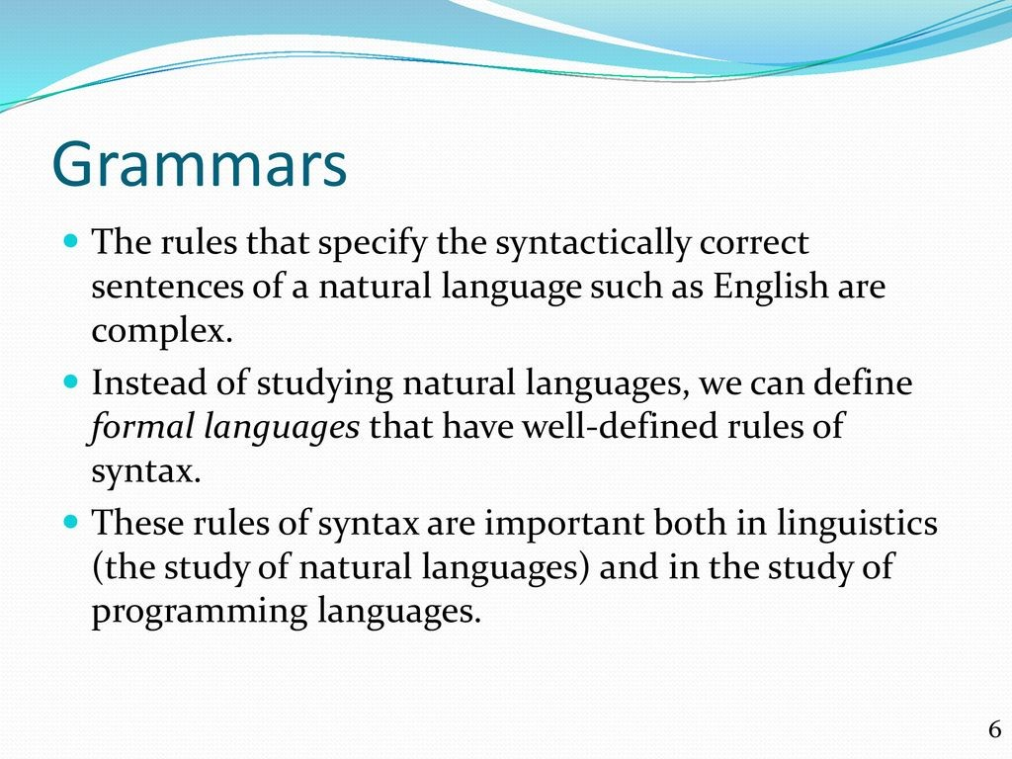

Slide 5
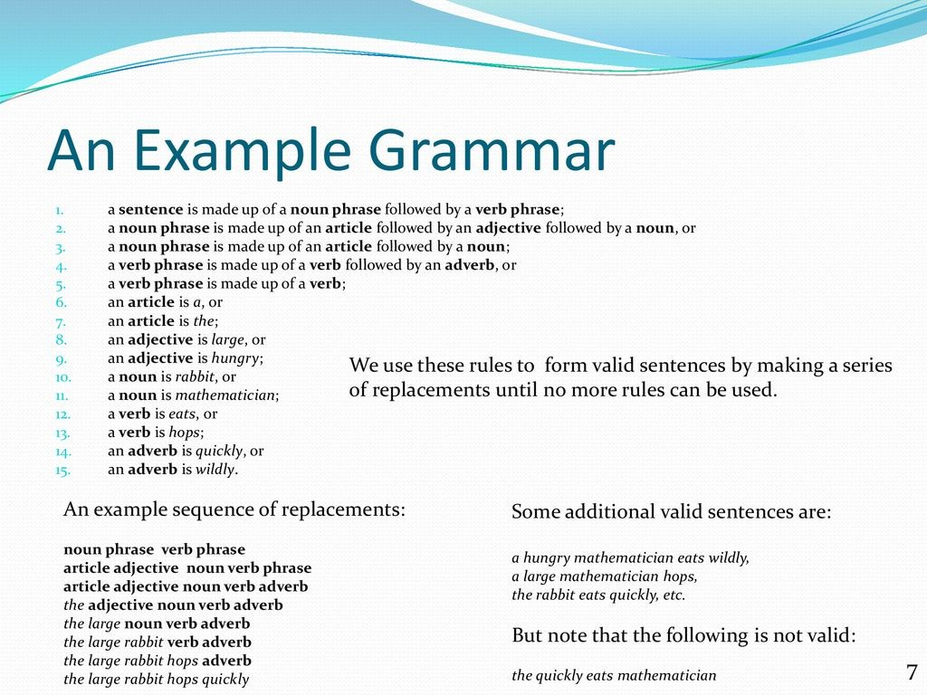

Slide 6
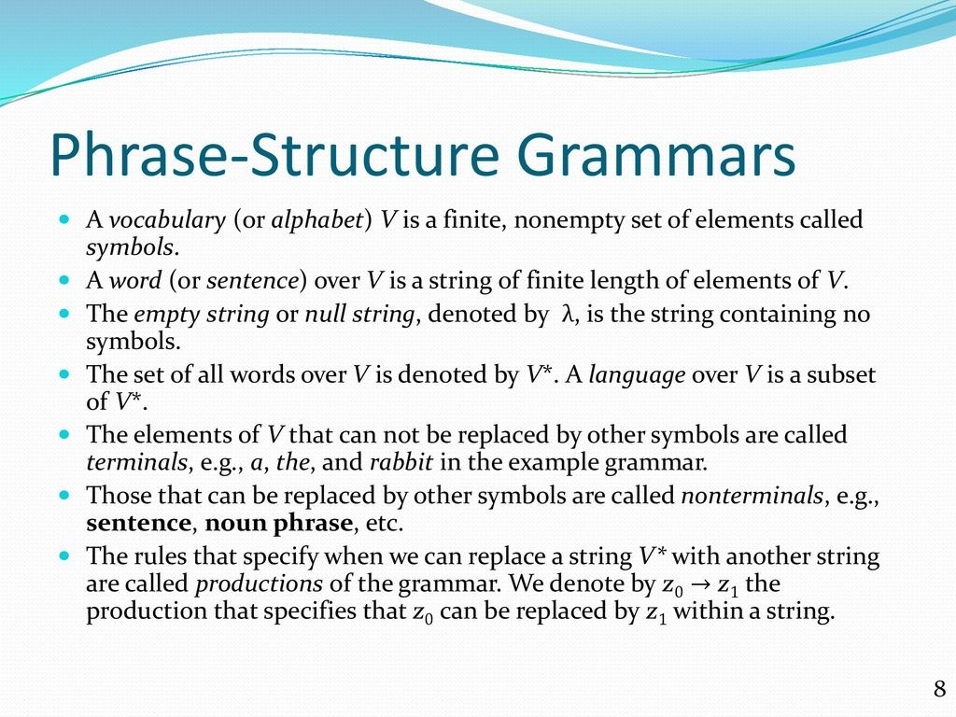

Slide 7
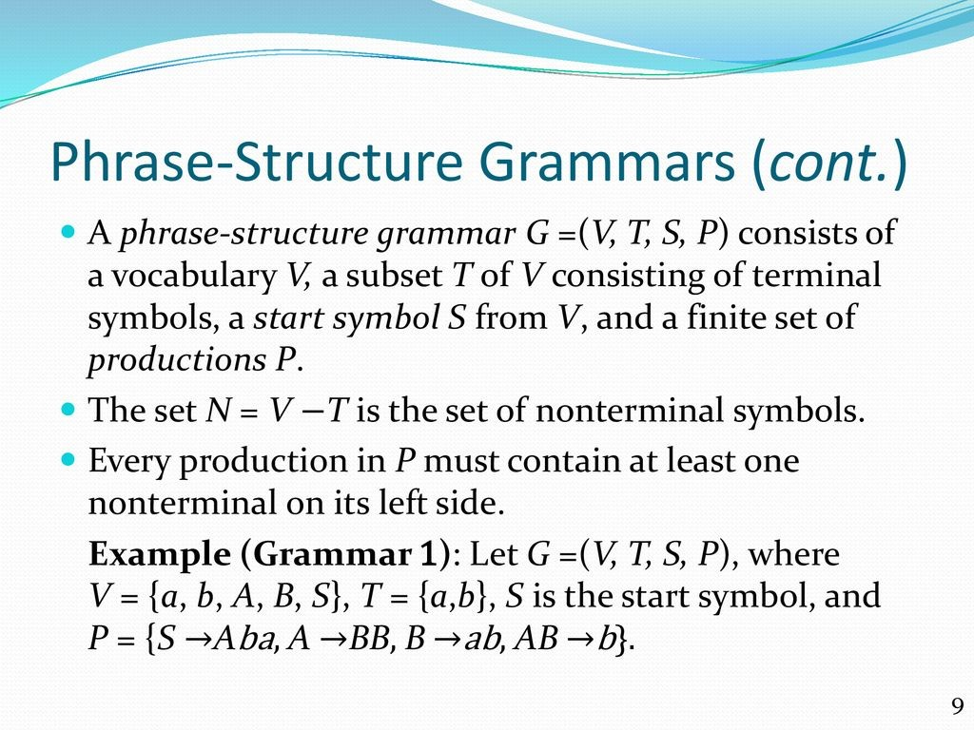

Slide 8
Symbol:
A symbol (often also called a character) is the smallest building block, which can be any alphabet, letter, or picture.
Alphabets (Σ):
Alphabets are a set of symbols, which are always finite.
String:
A string is a finite sequence of symbols from some alphabet. A string is generally denoted as w and the length of a string is denoted as |w|.
Empty string is the string with zero occurrence of symbols,
represented as ε. Nmber of Strings (of length 2) that can
be generated over the alphabet {a, b}:
- -
a a
a b
b a
b b
Length of String |w| = 2
Number of Strings = 4

Slide 9
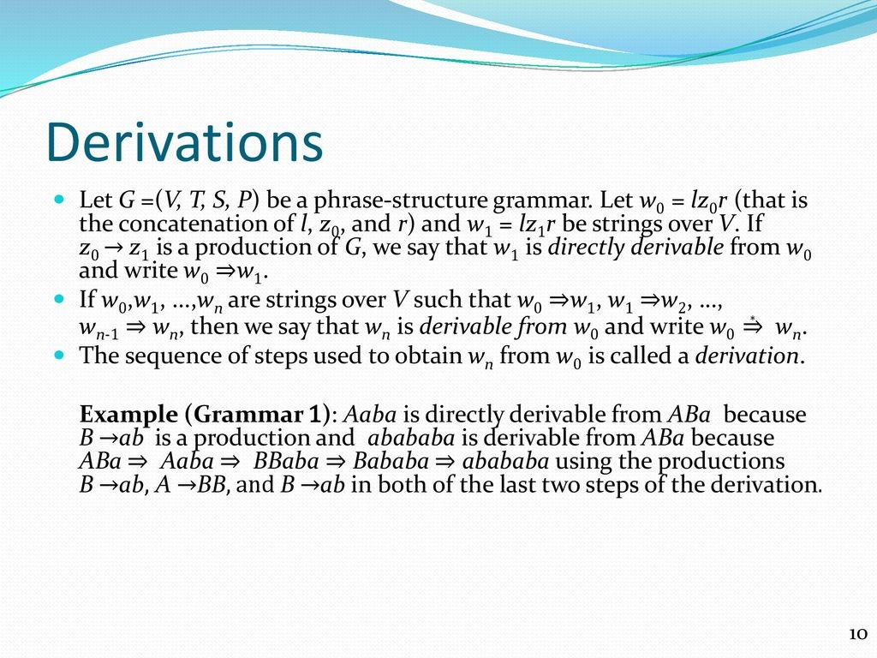

Slide 10
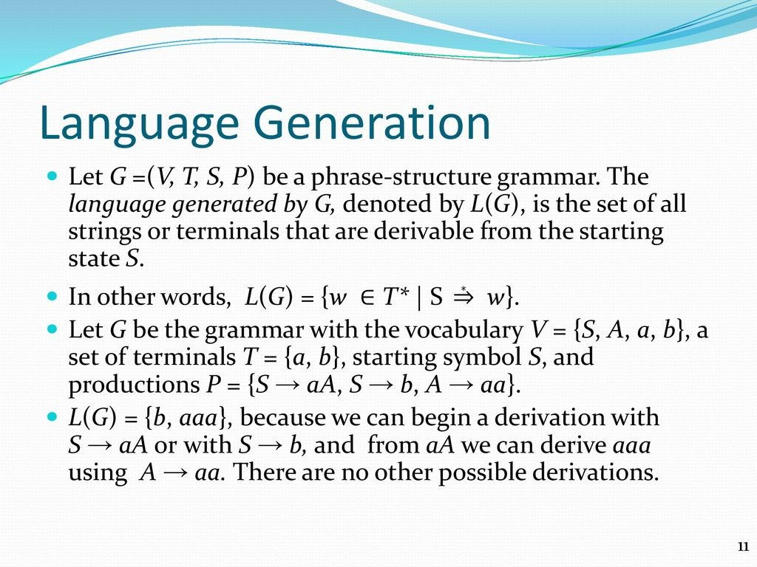

Slide 11
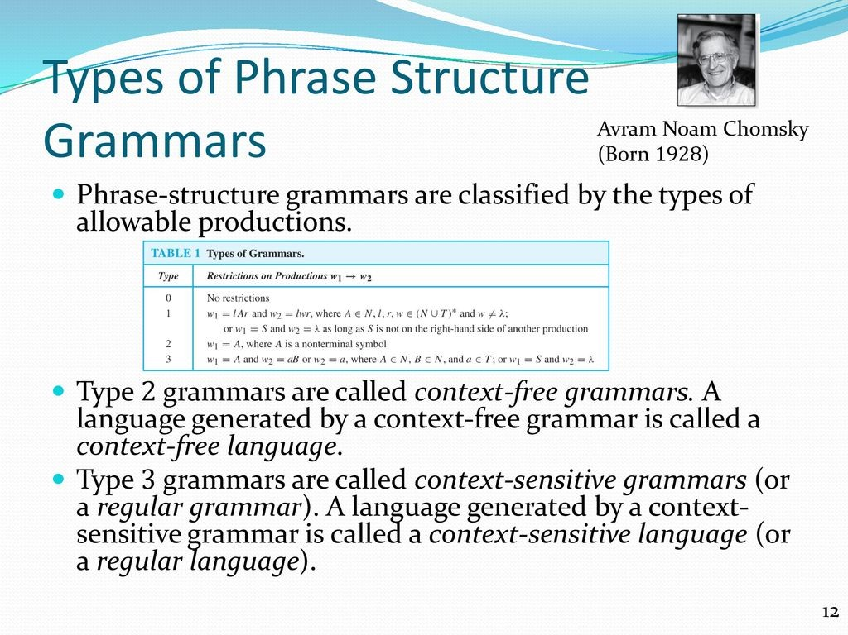

Slide 12
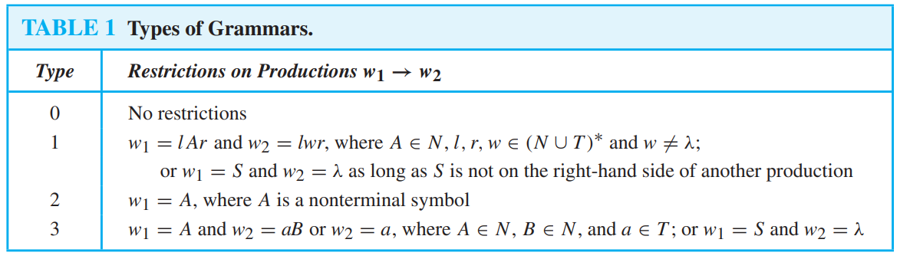

Slide 13
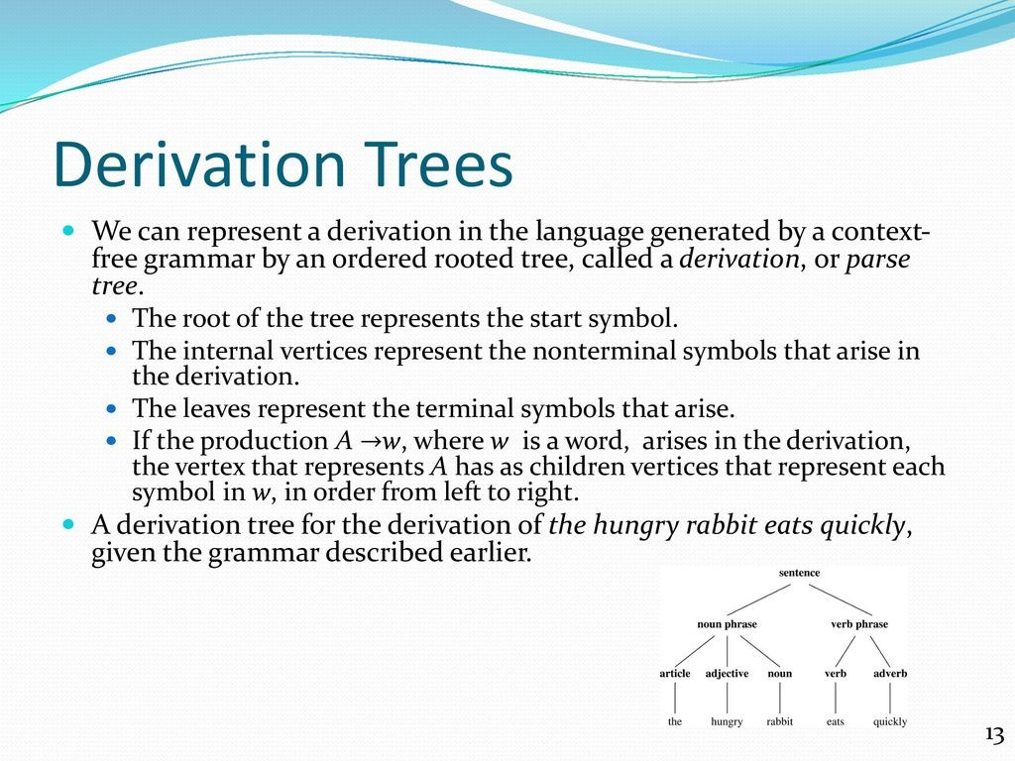

Slide 14
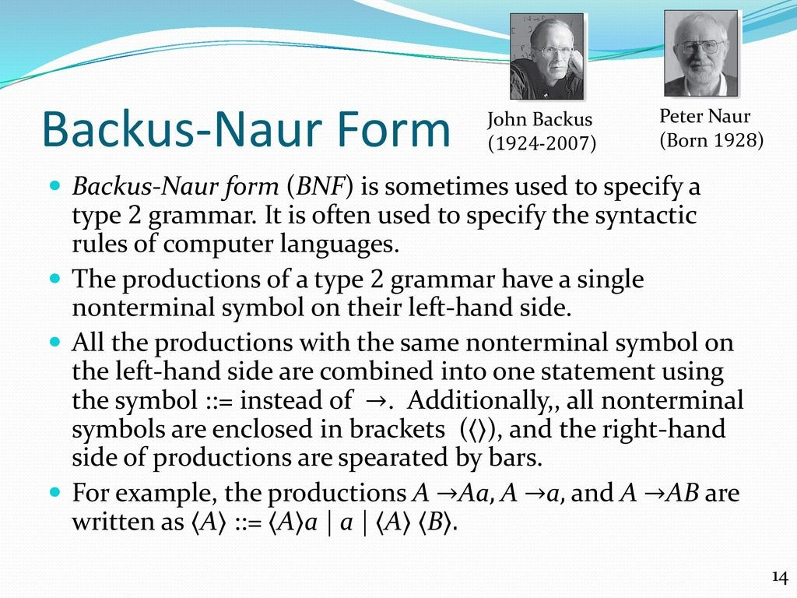

Slide 15
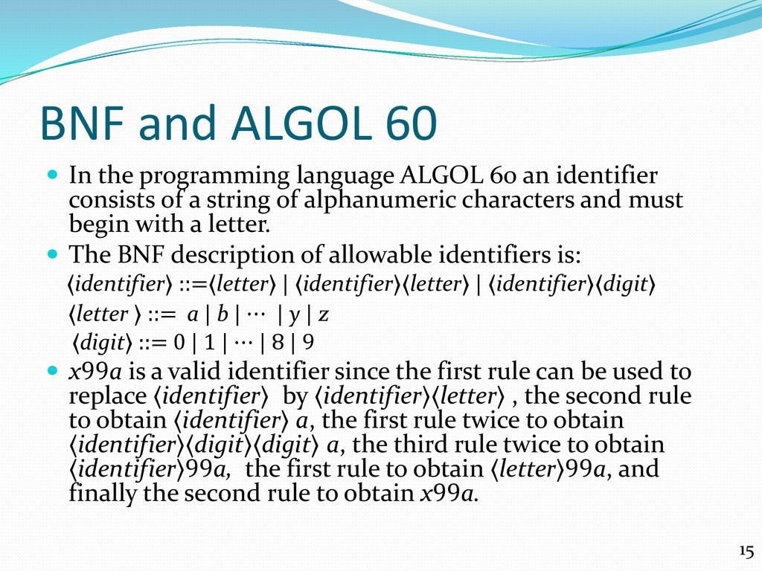

Slide 16
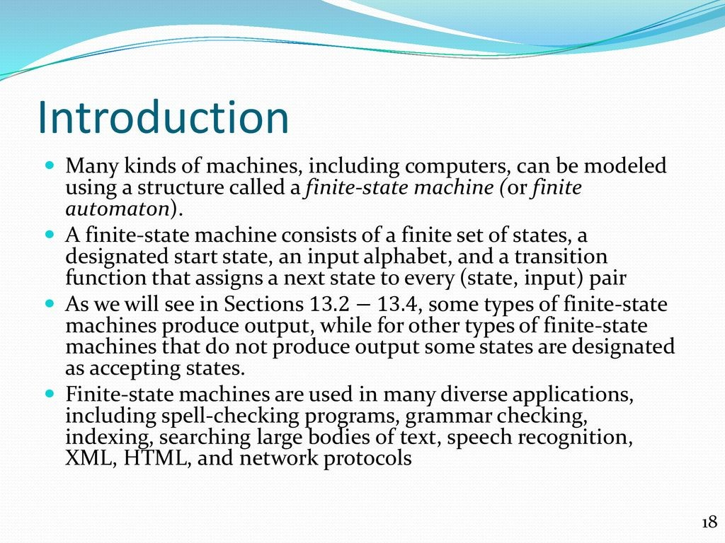
13.2 Finite-State Machines with Output

Slide 17
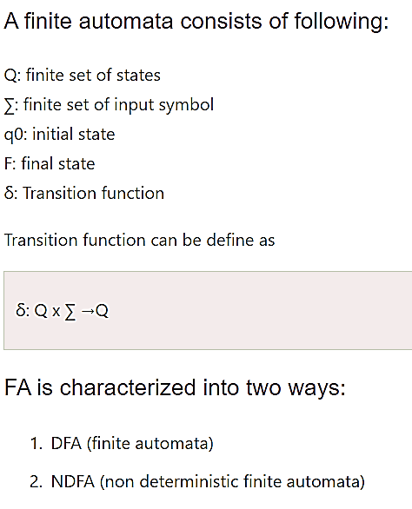
Finite state machine
Finite state machine is used to recognize patterns.
Finite automata machine takes the string of symbol as input and changes its state accordingly. In the input, when a desired symbol is found then the transition occurs.
While transition, the automata can either move to the next state or stay in the same state.
FA has two states: accept state or reject state. When the input string is successfully processed and the automata reached its final state then it will accept.

Slide 18
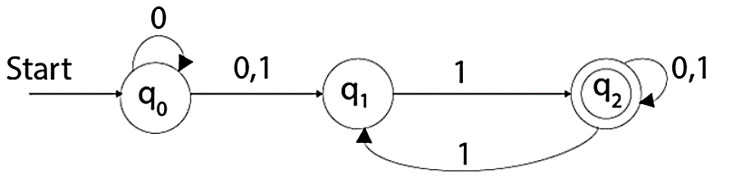
NDFA
NDFA refer to the Non Deterministic Finite Automata. It is used to transit the any number of states for a particular input. NDFA accepts the NULL move that means it can change state without reading the symbols.
NDFA also has five states same as DFA. But NDFA has different transition function.
Transition function of NDFA can be defined as:
δ: Q x ∑ →2^{Q}
Example
See an example of non deterministic finite automata:
Q = {q0, q1, q2}
∑ = {0, 1}
q0 = {q0}
F = {q3}

Slide 19
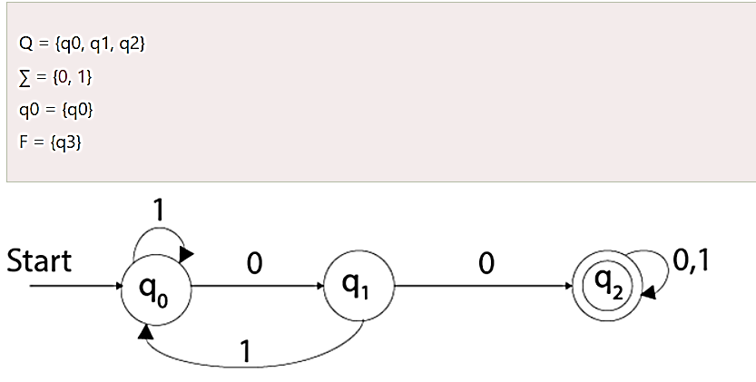
DFA
DFA stands for Deterministic Finite Automata. Deterministic refers to the uniqueness of the computation. In DFA, the input character goes to one state only. DFA doesn't accept the null move that means the DFA cannot change state without any input character.
DFA has five tuples {Q, ∑, q0, F, δ}
Q: set of all states
∑: finite set of input symbol where δ: Q x ∑ →Q
q0: initial state
F: final state
δ: Transition function
Example
See an example of deterministic finite automata:

Slide 20
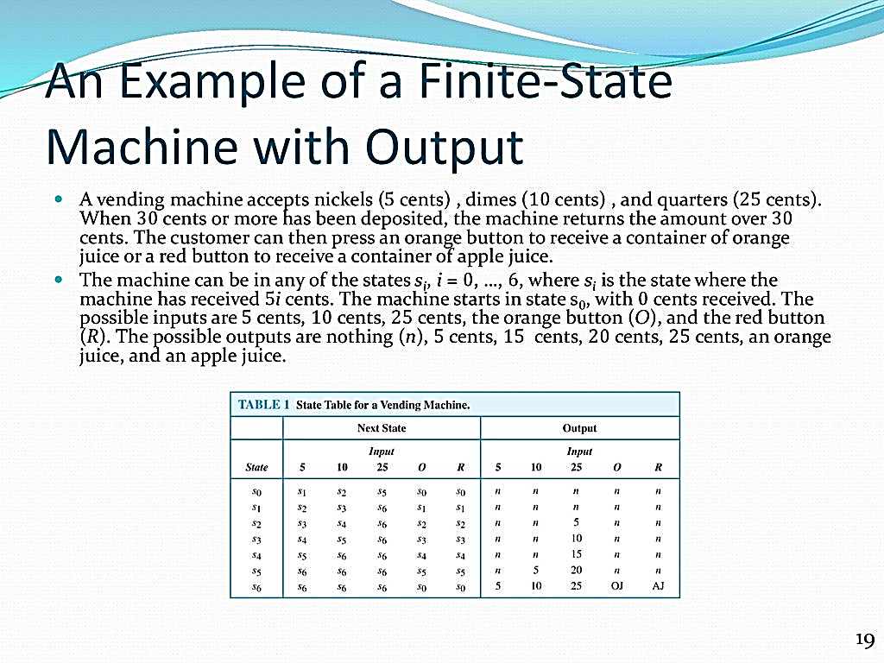

Slide 21
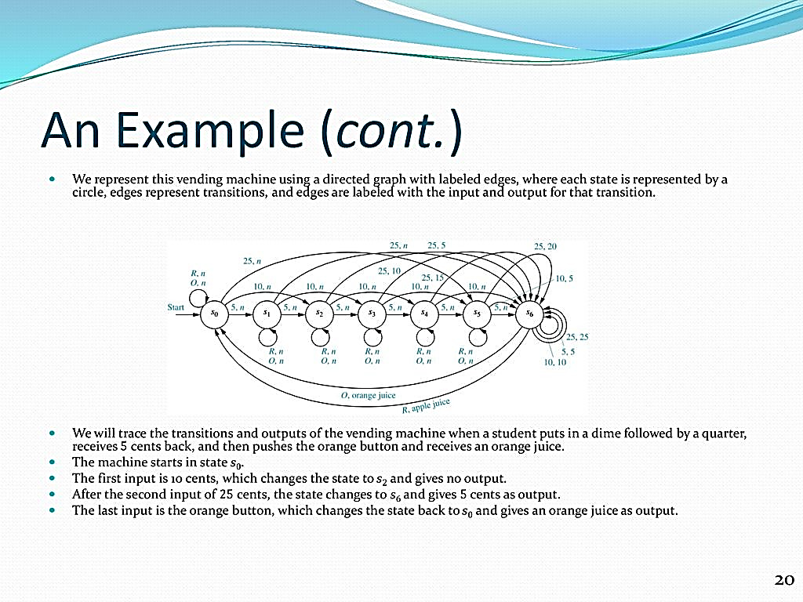

Slide 22
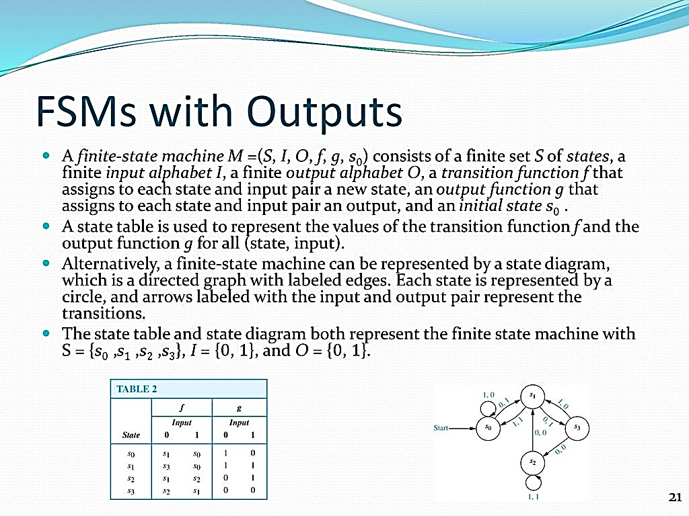

Slide 23
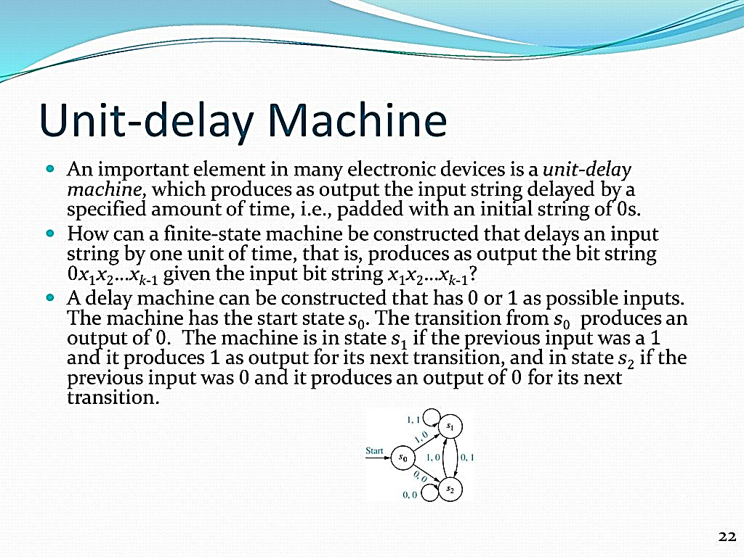

Slide 24
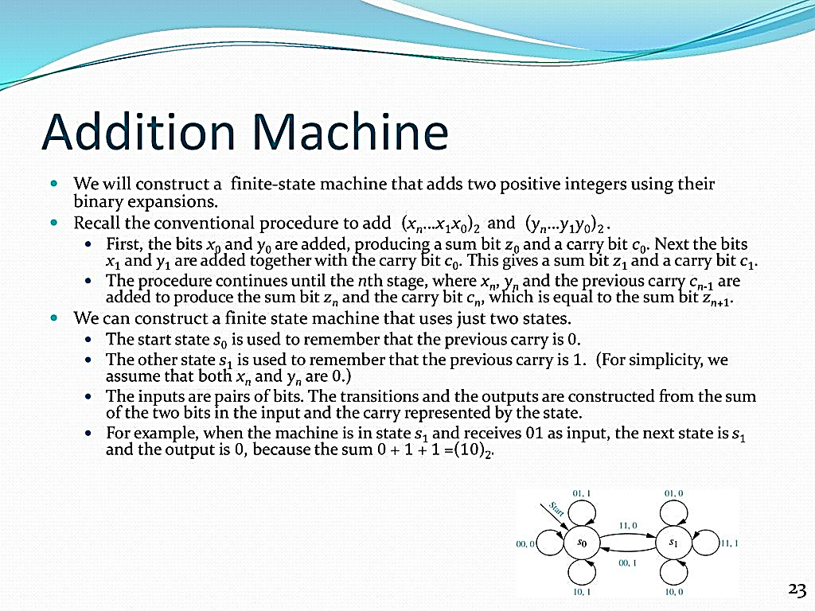

Slide 25
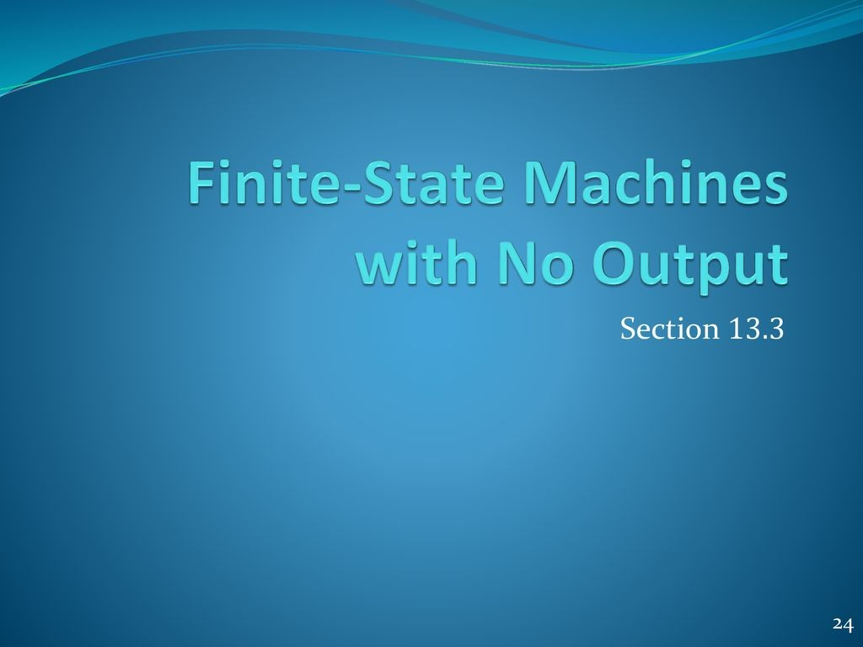

Slide 26
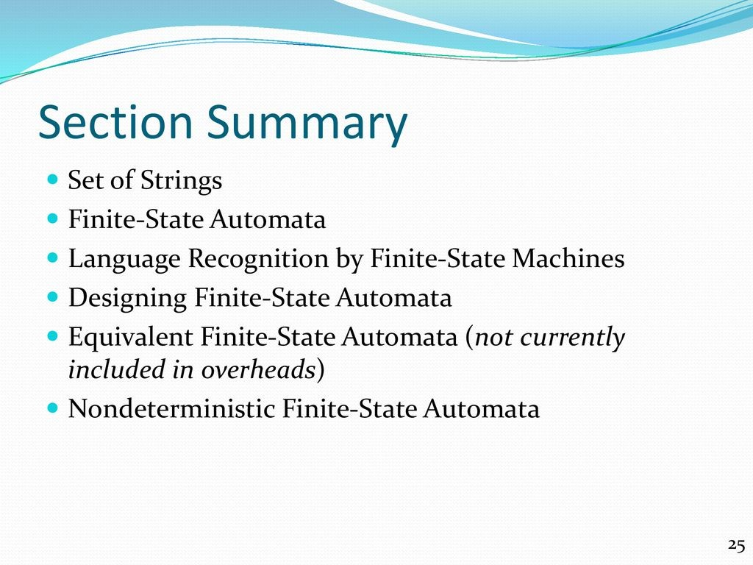

Slide 27
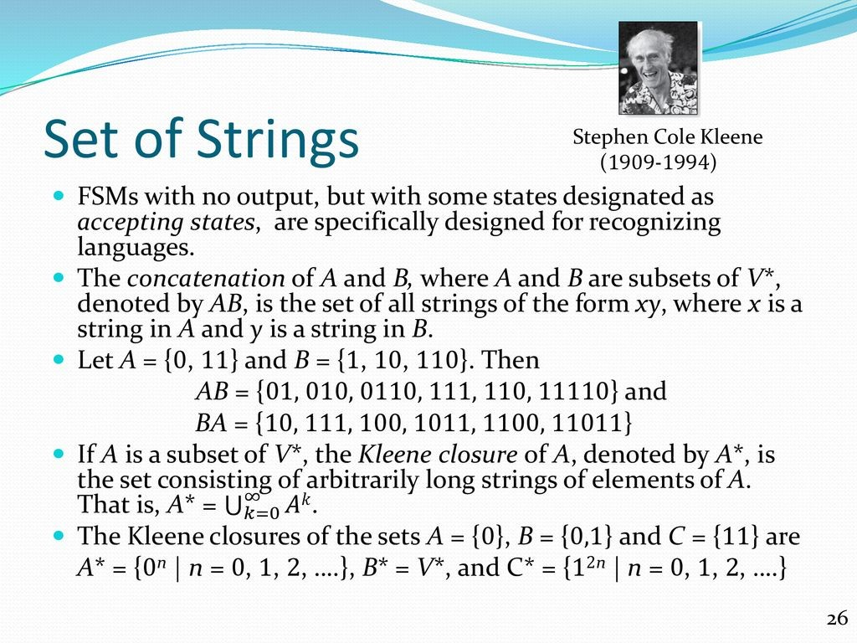

Slide 28
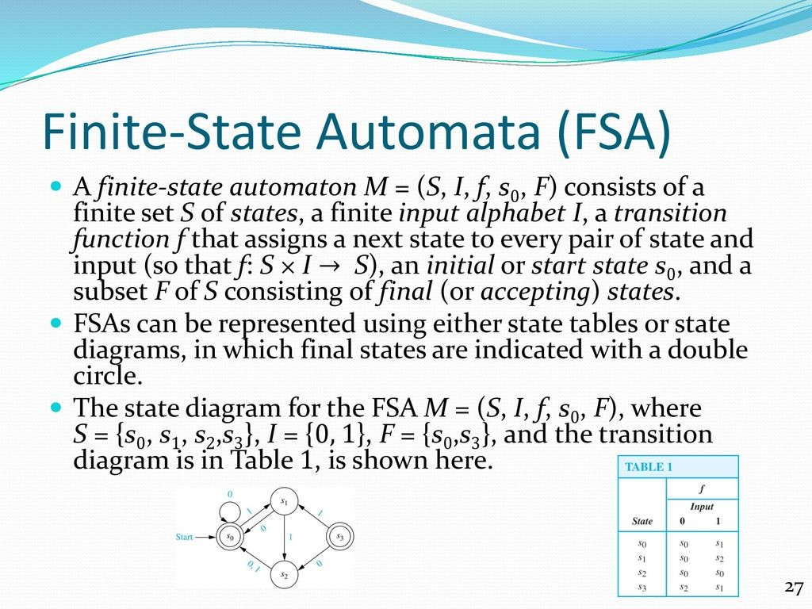

Slide 29
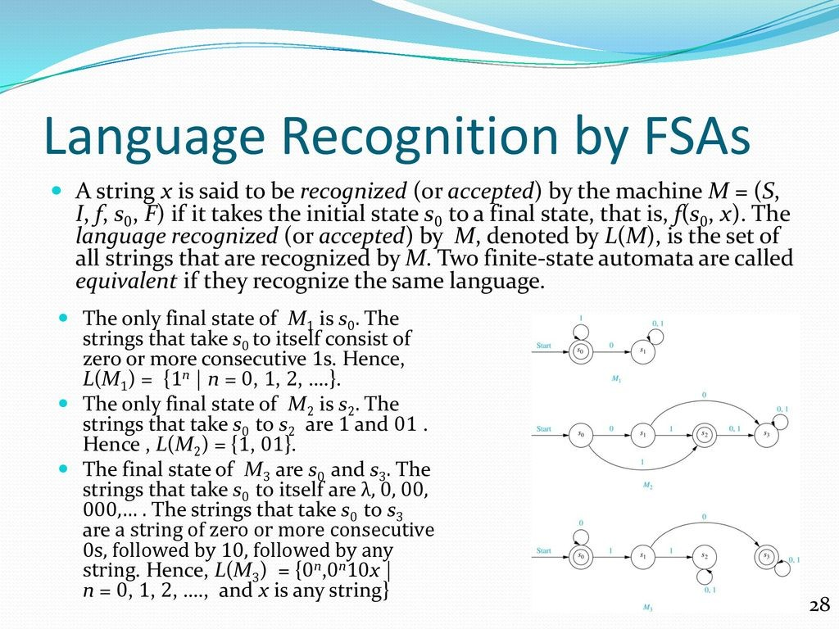

Slide 30
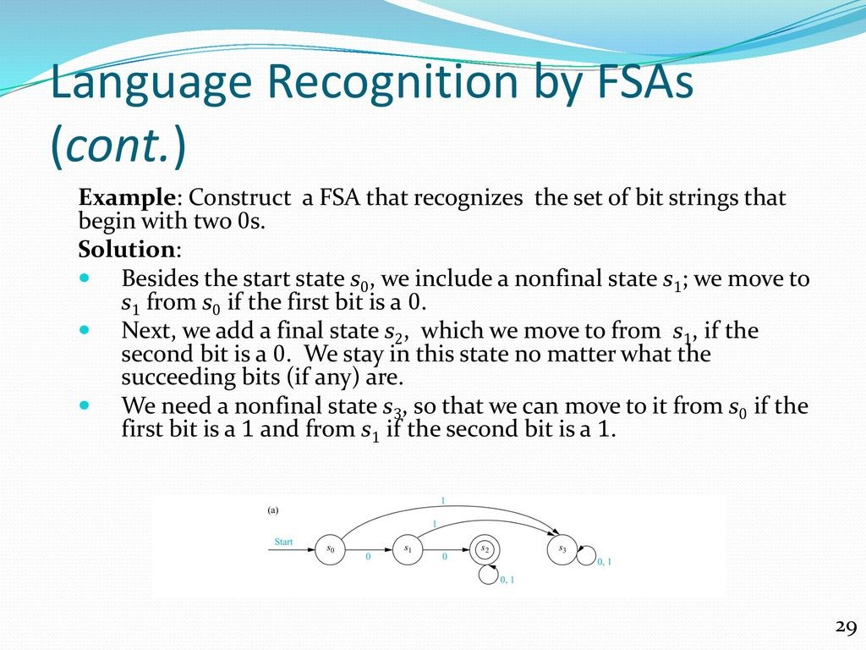

Slide 31
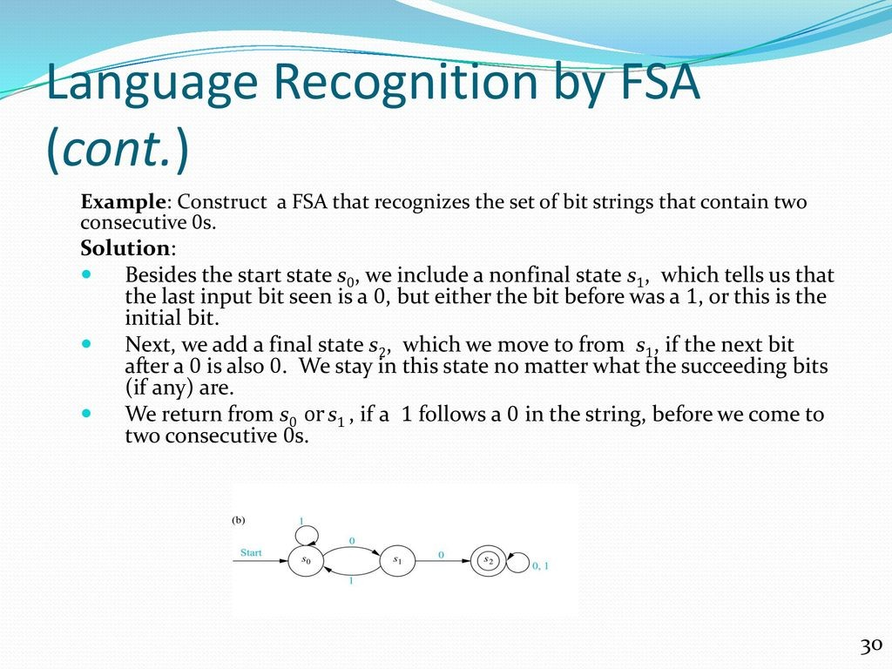

Slide 32
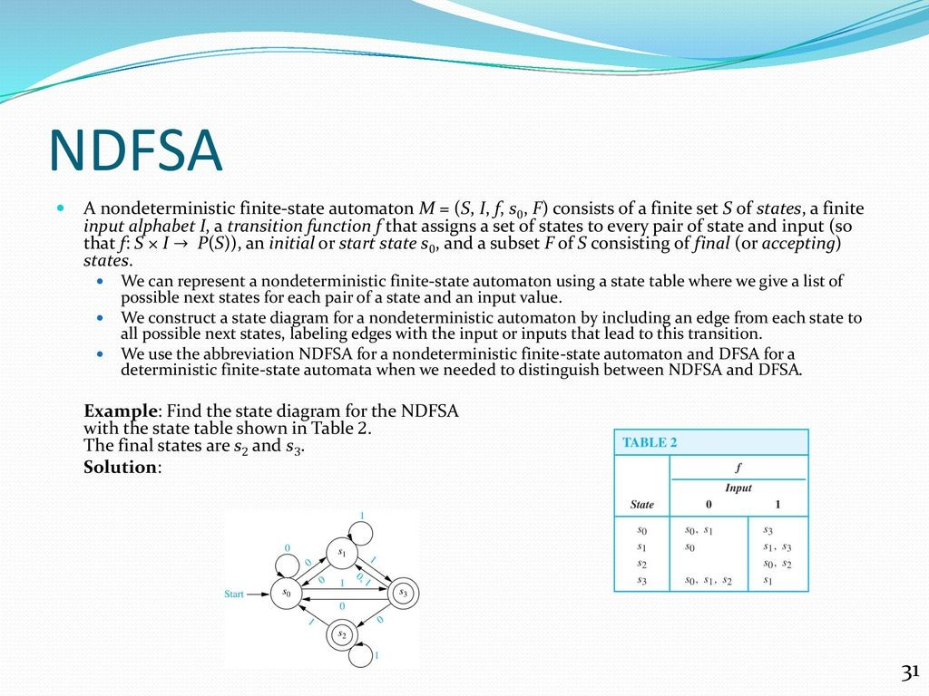

Slide 33
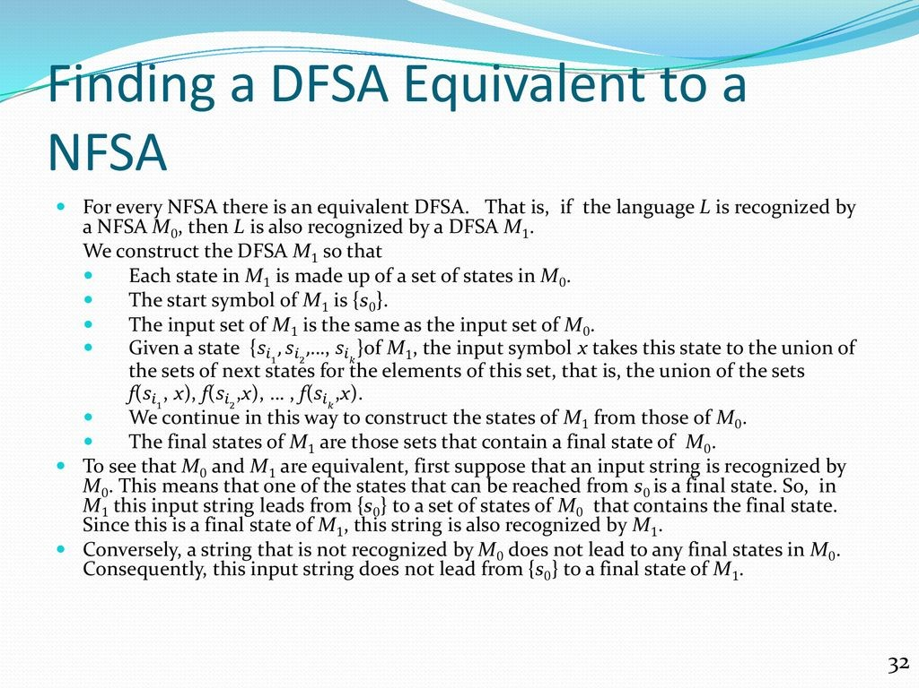

Slide 34
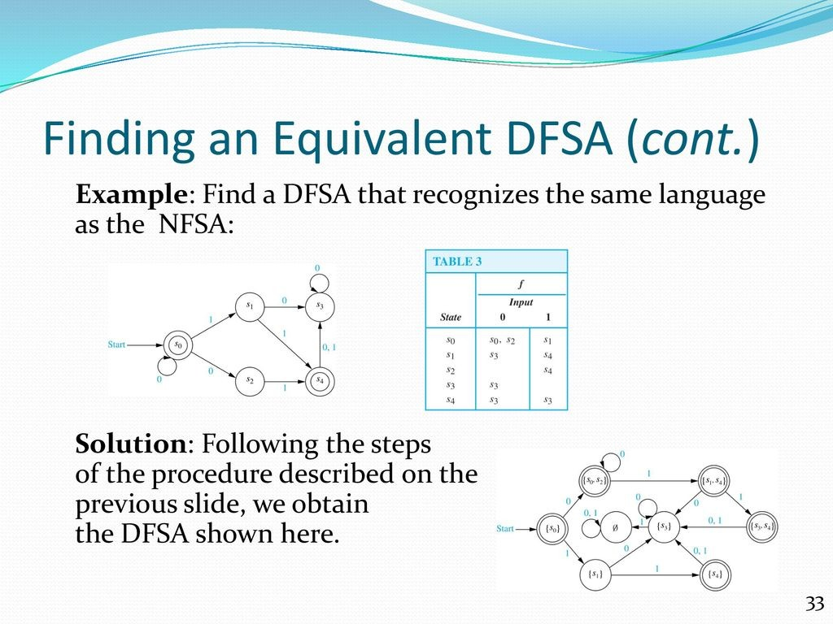

Slide 35
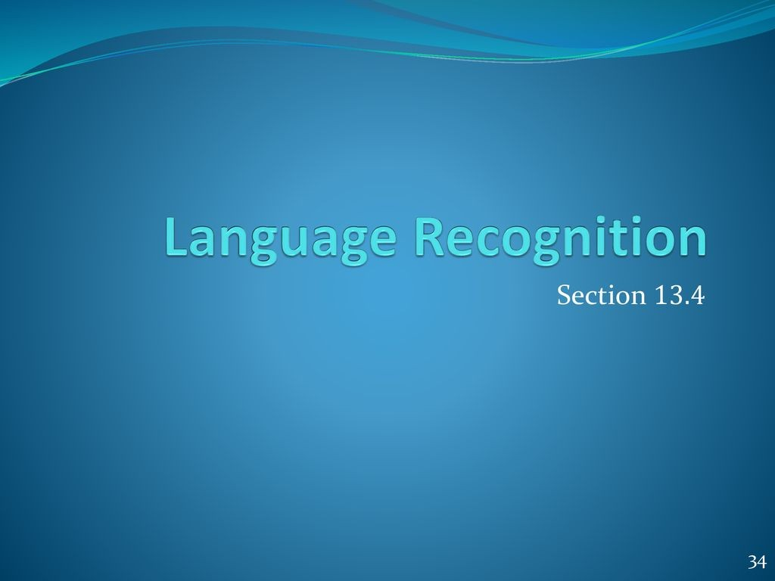

Slide 36
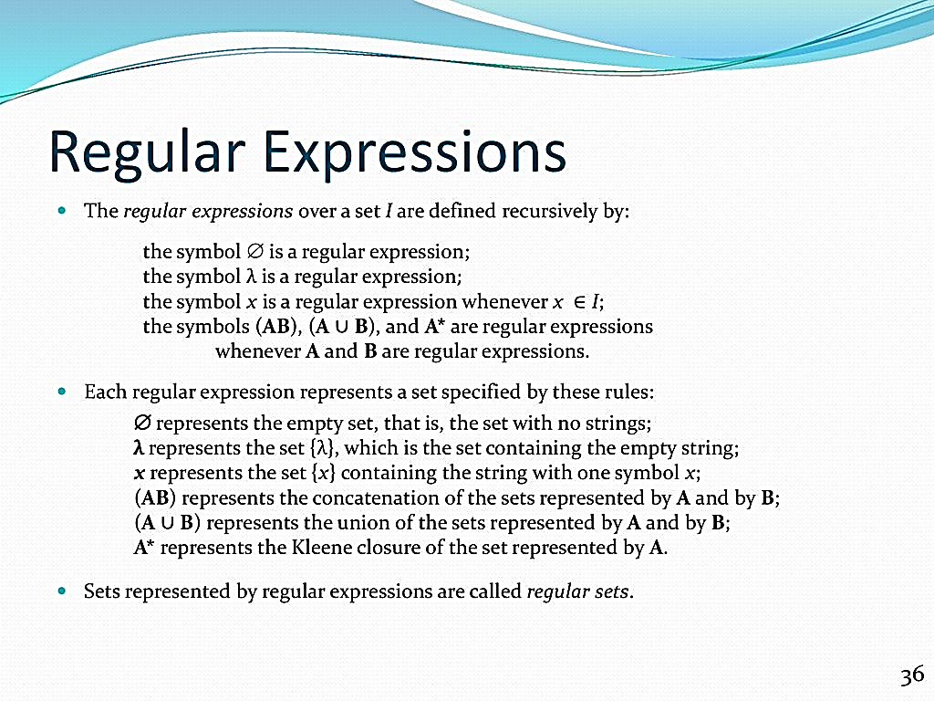
Regular Expressions

Slide 37
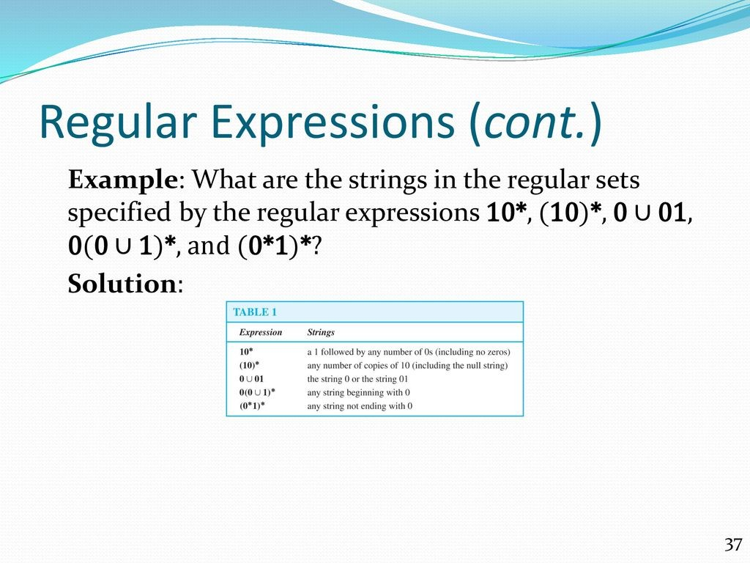

Slide 38
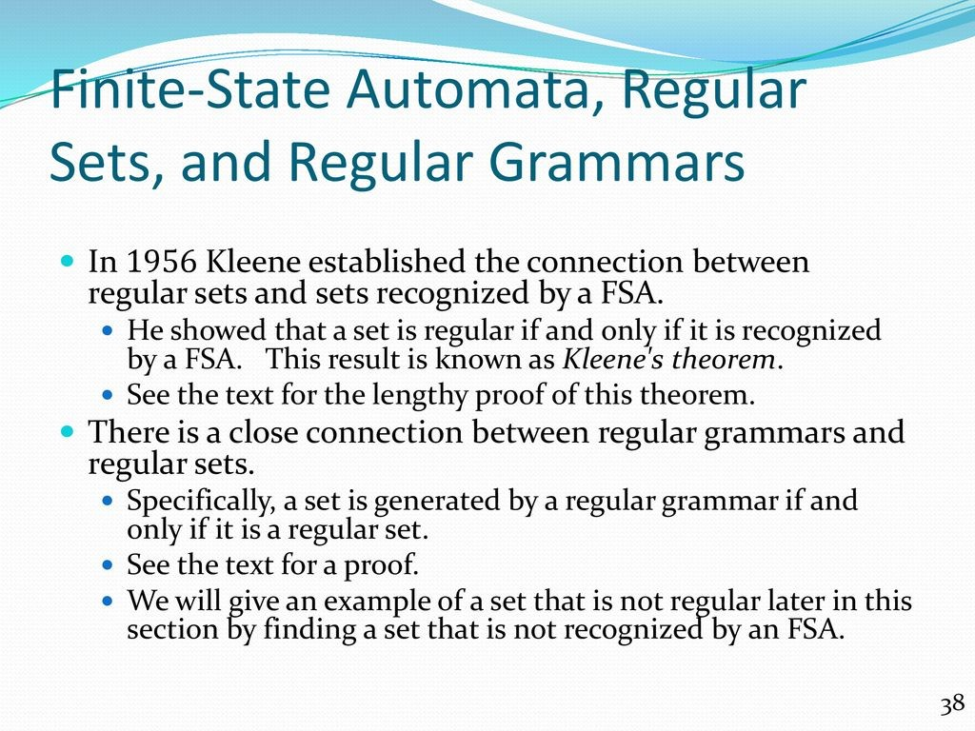

Slide 39
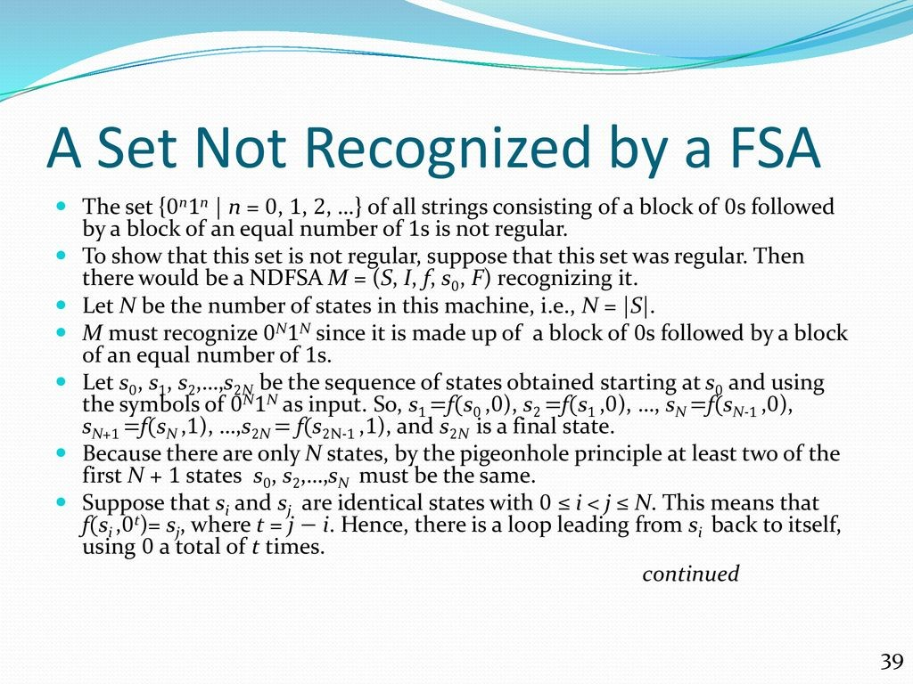

Slide 40
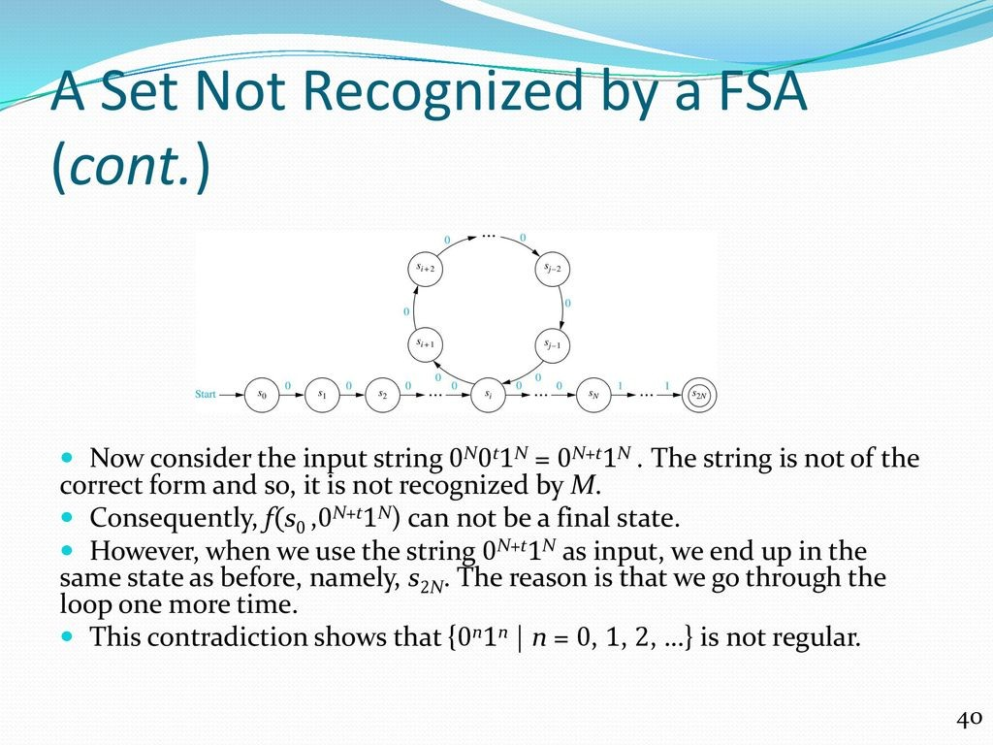

Slide 41
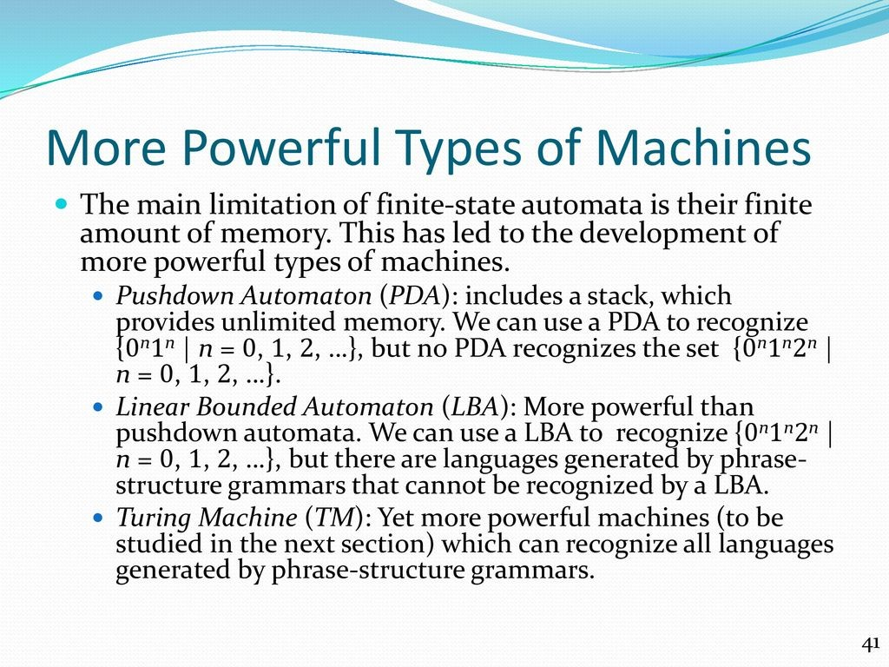

Slide 42
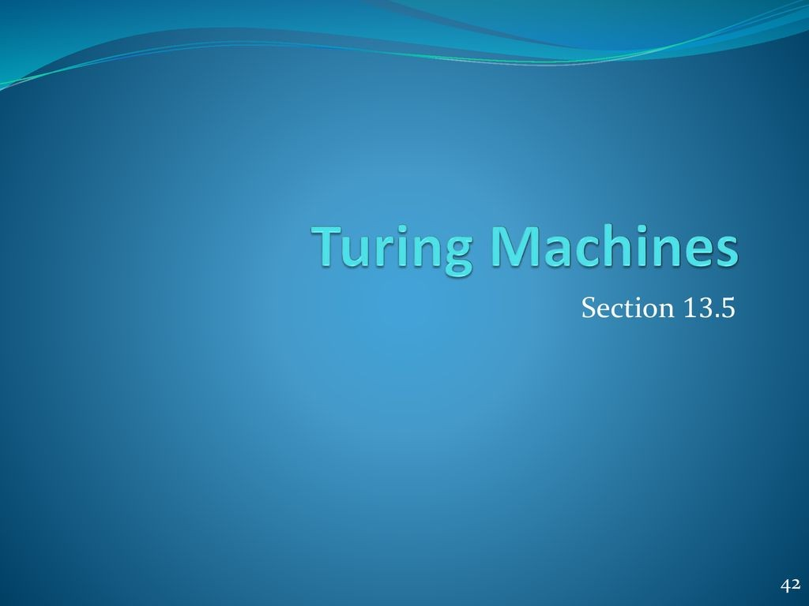

Slide 43
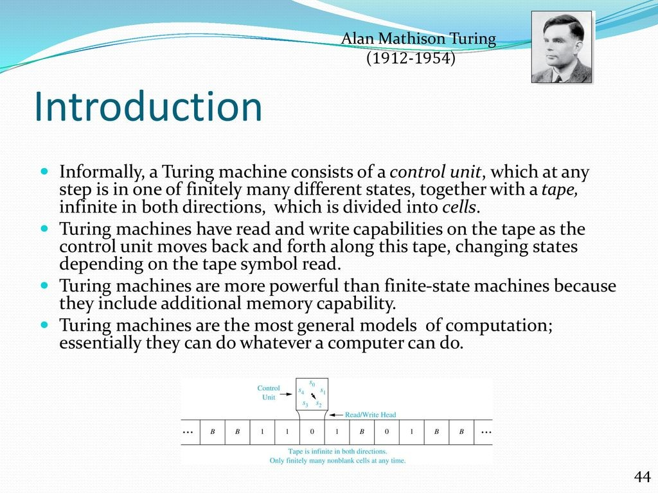

Slide 44
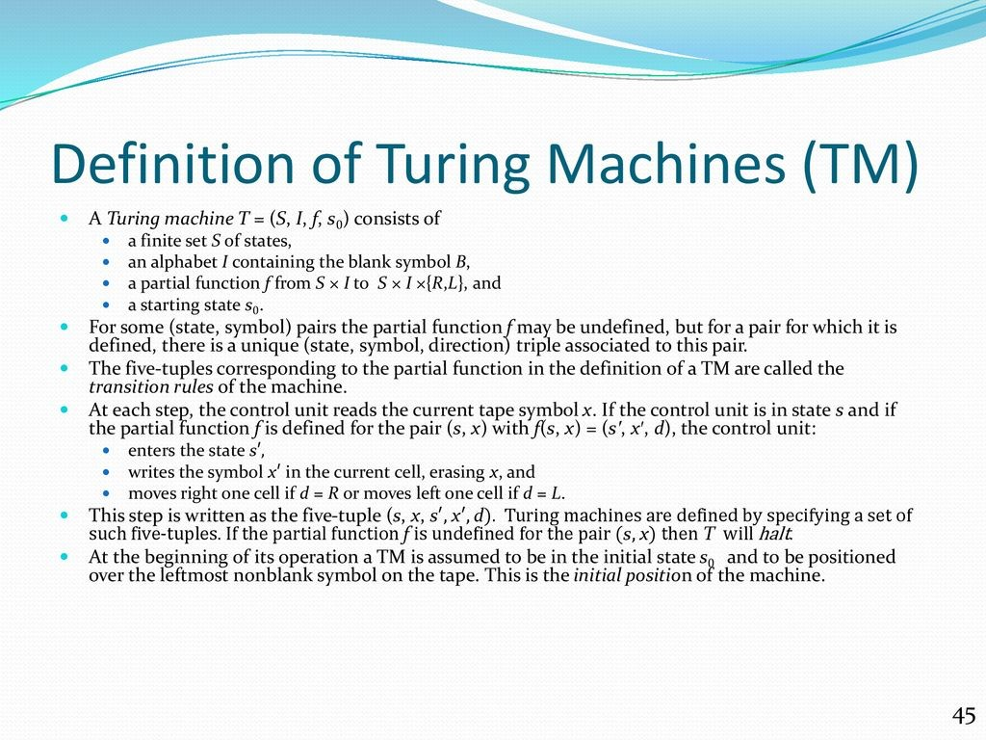

Slide 45
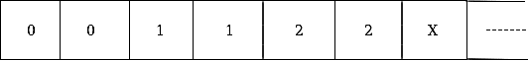
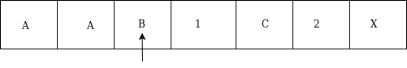
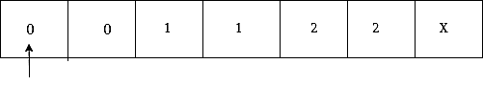
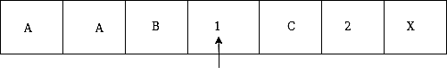
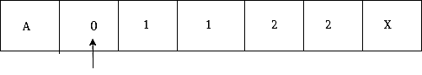
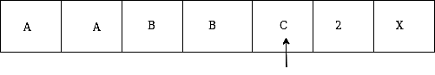
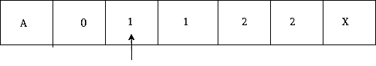
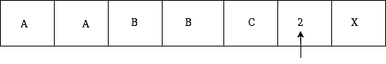
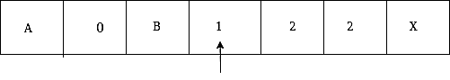





Construct a TM for the language L = {0^{n}1^{n}2^{n}} where n≥1
The simulation for 001122 can be shown as below:

Slide 46

The same TM can be represented by Transition Diagram:
The following are the different types /Varients of turing machines:
Multi-tape turing machine.
Multi-head turing machines.
Multi-track turing machines.
Semi-infinite turing machines.
Universal Turing Machine.
Alternating Turing machine.
Non-Deterministic Turing Machine.
Unambiguous Turing Machine.

Slide 47


Slide 48


Slide 49


Slide 50


Slide 51


Slide 52


Slide 53


Slide 54


Slide 55


Slide 56


Slide 57


Slide 58


